Slide 1



Where Every Tail Finds a Happy Ending
HAPPY TAILS

Slide 2




Objective
01.
02.
03.
To enable users to know about street dogs and pets near their home and residential areas
Facilitate the adoption of pets and allow users to hand over pets to blue cross if their medical condition worsend
Provide detailed pet care information for specific breeds

Slide 3



Features
01.
02.
03.
View a list of street dogs and pets available for adoption.
Add a new pet to the list.
View a detailed information about pet care for specific breed
Report sightings of street dogs or cats.
Hand over pets to blue cross if necessary

Slide 4


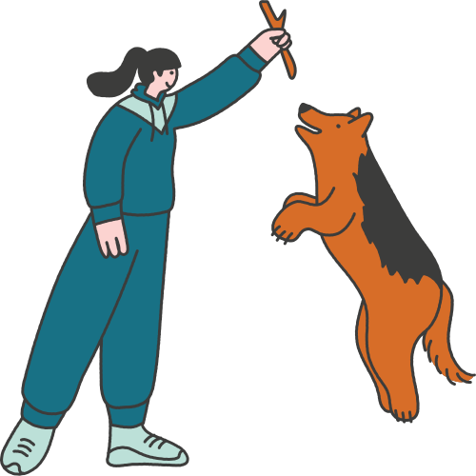
Project Structure
01.
02.
03.
04.
Screens/:
Contains UI Screens( Home screen, Add pet screen, Pet care screen)
main.dart:
Entry Point of the appplication
Models/:
Contains data models(e.g. Pet Model)
Providers/:
Contains state management logic(e.g. Petsprovider)

Slide 5


Widgets Used
01.
Scaffold: Provides a basic material design visual layout structure
02.
App Bar: Displays a material design visual layout structure
03.
ListView.builder: Builds a scrrollable list of widgets
04.
Navigator: Handles routing and navigation
05.
Change notifier provider: Used for state management with the Provider package

Slide 6

Home Screen
01.
02.
WIDGETS:
FUNCTIONALITY:
Displays a list of pet
Navigate to Add Pet screen
Navigate to Pet Care Screen with
detailed pet information
Scaffold
App bar
ListView.builder
Listtile
Icon Button

Slide 7

Add Pet Screen
01.
02.
Widgets:
Scaffold
AppBar
Text Form Field
Elevated Button
Functionality:
Allows users to add a
new pet to the list.
Includes fields for
pet name, breed, description.

Slide 8

Pet Care Screen
01.
WIDGETS:
Scaffold,AppBar,Padding,Column,text.
02.
FUNCTIONALITY:Displays pets available foadoption.
Allows users to select and adopt pets

Slide 9


Adoption Screen
WIDGETS:
Scaffold,AppBar,ListView.builder, ListTile
01.
FUNCTIONALITY:
Displays pets available for adoption.
Allows users to select and adopt pets.
02.

Slide 10

Conclusion
Happy Tails helps abandoned street animals to find a home.
Provides a platform for users to adopt pets and report sightings.
Facilitates pet care by providing detailed breed-specific information.
Empowers users to hand over pets to Blue Cross if necassary.

Slide 11

Question & Answers
Open Floor for Any Questions!!!

Slide 12


Presented By:
Prathipaa A.R.
Reddy Palli Rizwana
Sri Nithi .A
Swaathy.B
Trisha D.Y

